Slide 1
RLMO Round Table Meeting
Thursday, 8 October 2020
10:00–14:00 UTC
RLMO RT Chairperson: Dr. Charles Ehrlich, CIML 1st VP

Slide 2
RLMO Round Table Meeting
Agenda
1. Welcome by the RLMO RT Chairperson (Dr. Charles Ehrlich)
2. Roll call
3. Overview of the RLMO discussion topics
4. Updates from the RLMOs
AFRIMETS (Mr. Jaco Marneweck)
APLMF (Mr. Stephen O’Brien)
COOMET (Dr. Peter Ulbig)
GULFMET (Eng. Omar Kanakrieh)
SIM (Mr. Pedro Pérez Vargas)
WELMEC (Dr. Pavel Klenovský)
5. Update from SAARC (Mr. Ashutosh Agarwal)
6. Update from the CEEMS AG Chairperson (Mr. Peter Mason)
7. Update from the OIML-CS Executive Secretary (Mr. Paul Dixon)
8. Open Forum on the RLMO discussion topics
9. Future collaborations
10. Conclusions
11. Any other business

Slide 3
RLMO discussion topics
1. Under the current circumstances (pandemic, travel, financial, etc.), have any of your RLMOs been able to conduct any business since last October (in-person and/or online)?
2. How is your RLMO coping with the pandemic situation? What short-term and long-term changes you foresee to your RLMO?
3. How might the relationship between the OIML and the RLMOs be enhanced or augmented?
a. What do RLMOs do that the OIML does not or cannot do?
  b. How can the OIML better help your region/economies? What are your most urgent regional/economies’ needs from the OIML (e.g., R 76 pilot, D 1, etc.)?
c. Does any duplication of activities exist within regional bodies, between regional bodies, and with the OIML?
d. In cases where RLMOs and RMOs are different organizations in the same region, how is coordination accomplished, both between themselves and with the BIML and the BIPM?

Slide 4
RLMO discussion topics
4. How might the scope of the RLMO Round Table be expanded to enhance collaboration and sharing of ideas beyond just reporting by the RLMO representatives at the annual RT meetings?
How might the RLMO Round Table be restructured to better serve your needs?
a. Share training materials, including e-learning modules, among RLMOs?
b. Send representatives to each other’s RLMO meetings?
c. Formalize the relationships between the RLMOs and OIML, including development of Terms of Reference (ToR) for the RLMO Round Table?
d. Should the OIML formalize what it considers to be an RLMO (e.g., what kind of grouping is/represents an RLMO)?
e. Should there be membership/participation criteria for the RLMO Round Table?

Slide 5
RLMO discussion topics
5. Should the individual RLMO reporting format at future RLMO Round Table meetings be standardized in order to focus discussion on certain topics? Topics could include:
Is your RLMO a legal entity? If not, are there plans to move in that direction?
Do you feel that there is ‘dumping’ of measuring instruments (that is, intentional sale of measuring instruments that do not meet verification requirements) going on in your region? If so, in what area(s)?
c. How do the economies in your region participate in the OIML-CS?
d. Are there any impediments to participation?
e. Do the economies in your region accept OIML Certificates/Test data?

Slide 6
RLMO discussion topics
6. Does your RLMO have any suggestions on how the OIML Bulletin might become more valuable to your RLMO, and to the OIML, in the future?
a. What useful articles can your RLMO provide for the Bulletin?
b. Should the RLMO reports presented at the RLMO Round Table meeting be made available in a separate RLMO Round Table section of the OIML web site, and/or in the OIML Bulletin?
Of course, all of these possibilities would require resources (financial and time) that may not be available, and since some (most? all?) of the RLMOs are not legal entities a more formal relationship with the OIML might not be feasible.
However, these are questions that could be explored as part of investigating whether an enhanced role/scope of the RLMO Round Table makes sense.

Slide 7
Reports from RLMOs
Mr. Jaco Marneweck (South Africa) AFRIMETS
Mr. Stephen O’Brien (New Zealand) APLMF
Dr. Peter Ulbig (Germany) COOMET
Mr. Omar Kanakrieh (Saudi Arabia) GULFMET
Mr. Pedro Pérez Vargas (Colombia) SIM
Mr. Pavel Klenovsky (Czech Republic) WELMEC
Report on SAARC
Mr. Ashutosh Agarwal (India) SAARC

Slide 8
Update on CEEMS-AG
Mr. Peter Mason,
Chairperson of CEEMS-AG

Slide 9
Update on OIML -CS
Mr. Paul Dixon,
Executive Secretary of OIML-CS

Slide 10
Open Forum on the
RLMO Discussion Topics

Slide 11
RLMO discussion topics
1. Under the current circumstances (pandemic, travel, financial, etc.), have any of your RLMOs been able to conduct any business since last October (in-person and/or online)?
2. How is your RLMO coping with the pandemic situation? What short-term and long-term changes you foresee to your RLMO?
3. How might the relationship between the OIML and the RLMOs be enhanced or augmented?
a. What do RLMOs do that the OIML does not or cannot do?
  b. How can the OIML better help your region/economies? What are your most urgent regional/economies’ needs from the OIML (e.g., R 76 pilot, D 1, etc.)?
c. Does any duplication of activities exist within regional bodies, between regional bodies, and with the OIML?
d. In cases where RLMOs and RMOs are different organizations in the same region, how is coordination accomplished, both between themselves and with the BIML and the BIPM?

Slide 12
RLMO discussion topics
4. How might the scope of the RLMO Round Table be expanded to enhance collaboration and sharing of ideas beyond just reporting by the RLMO representatives at the annual RT meetings?
How might the RLMO Round Table be restructured to better serve your needs?
a. Share training materials, including e-learning modules, among RLMOs?
b. Send representatives to each other’s RLMO meetings?
c. Formalize the relationships between the RLMOs and OIML, including development of Terms of Reference (ToR) for the RLMO Round Table?
d. Should the OIML formalize what it considers to be an RLMO (e.g., what kind of grouping is/represents an RLMO)?
e. Should there be membership/participation criteria for the RLMO Round Table?

Slide 13
RLMO discussion topics
5. Should the individual RLMO reporting format at future RLMO Round Table meetings be standardized in order to focus discussion on certain topics? Topics could include:
Is your RLMO a legal entity? If not, are there plans to move in that direction?
Do you feel that there is ‘dumping’ of measuring instruments (that is, intentional sale of measuring instruments that do not meet verification requirements) going on in your region? If so, in what area(s)?
c. How do the economies in your region participate in the OIML-CS?
d. Are there any impediments to participation?
e. Do the economies in your region accept OIML Certificates/Test data?

Slide 14
RLMO discussion topics
6. Does your RLMO have any suggestions on how the OIML Bulletin might become more valuable to your RLMO, and to the OIML, in the future?
a. What useful articles can your RLMO provide for the Bulletin?
b. Should the RLMO reports presented at the RLMO Round Table meeting be made available in a separate RLMO Round Table section of the OIML web site, and/or in the OIML Bulletin?
Of course, all of these possibilities would require resources (financial and time) that may not be available, and since some (most? all?) of the RLMOs are not legal entities a more formal relationship with the OIML might not be feasible.
However, these are questions that could be explored as part of investigating whether an enhanced role/scope of the RLMO Round Table makes sense.

Slide 15
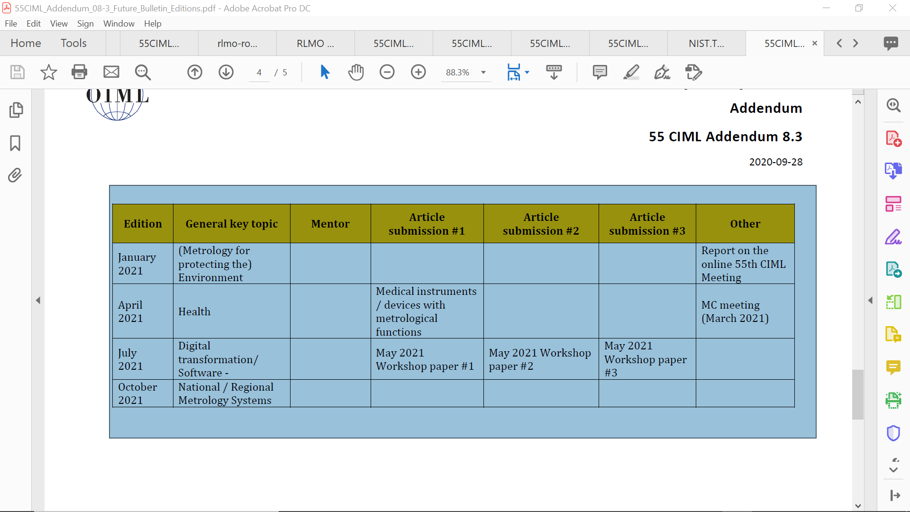
OIML Bulletin

Slide 16
Future Collaborations

Slide 17
Conclusions

Slide 18
Any other business?

Slide 19
Thank you!

